Slide 1





Digitizing the Accounts Payable System at
B. LABAN Using Oracle ERP

Slide 2






THE TEAM
NXT8_CAI2_ERP4_S1
Oracle Digital Accounting Specialist
Team Leader
Member
Member
Member
Member
Abd El-Rahman
Hossam
Mostafa Mohamed
Mariam Adel
Youssef Mohamed
Tuka Khaled

Slide 3
TABLE OF CONTENTS
Introduction to ERP, Oracle and B.LABAN
Create:
New Accounts Payable Responsibility & Profile Options
New Inventory Organization
Setup:
Financial Options
Payables System Setup
Payable Options
Create Recurring Invoice
Accounts Payables Closing Process and Transfer to General Ledger
Accounts Payables Reports
Open Payables Period
Create:
New Supplier
Bank
Bank Branch
Bank Account
Bank Document
Actions Apply Available Prepayment Invoice
Create:
Expense Report Invoice
Recurring Invoice
Withholding Tax Invoice
AP Closing Steps
Cash Management Module - AP Section
Create:
Standard Invoice on new supplier
USD Standard Invoice
Payment:
Standard Invoice
Cancel:
Invoice
Paid Invoice

Slide 4

INTRODUCTION
01
ERP SYSTEMS

Slide 5






1.ERP SYSTEMS
Before ERP: The Legacy Systems Era
Before the advent of ERP systems, organizations often managed their operations using a collection of disparate and siloed systems.
Many departments relied on specialized, standalone software or even manual, paper-based processes to carry out their daily tasks.
This fragmentation led to several challenges:
Data Inconsistency Limited Visibility Operational Inefficiencies
Higher Costs Scalability Issues

Slide 6

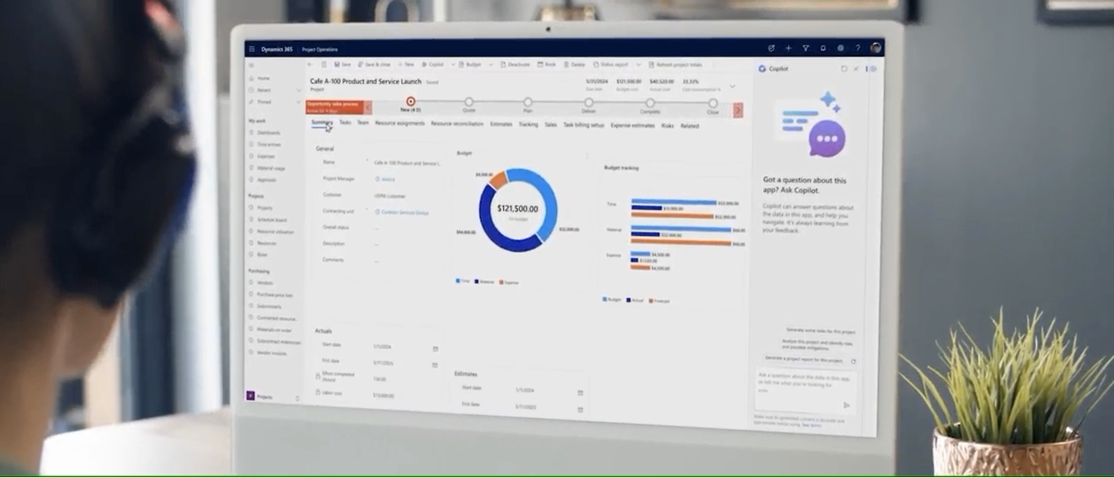







1.ERP SYSTEMS
After ERP: Transforming Business Operations
The introduction of ERP systems revolutionized how organizations manage their operations by unifying all core business functions into a single, integrated platform.
With ERP, companies can experience significant improvements across various dimensions:
Integrated Data Management Enhanced Visibility Streamlined Processes
Cost Efficiency Agility and Scalability Improved Compliance

Slide 7

1.ERP SYSTEMS
Most Common ERP Software Solutions
Oracle E-Business Suite / Fusion Cloud
Integrated suite covering financials, SCM, HCM, and more
Available as on-premises or cloud
GL AP AR
CASH MANAGEMENT
FIXED ASSET

Slide 8

INTRODUCTION
02
ACCOUNT PAYABLE

Slide 9
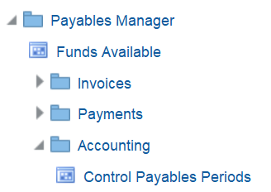
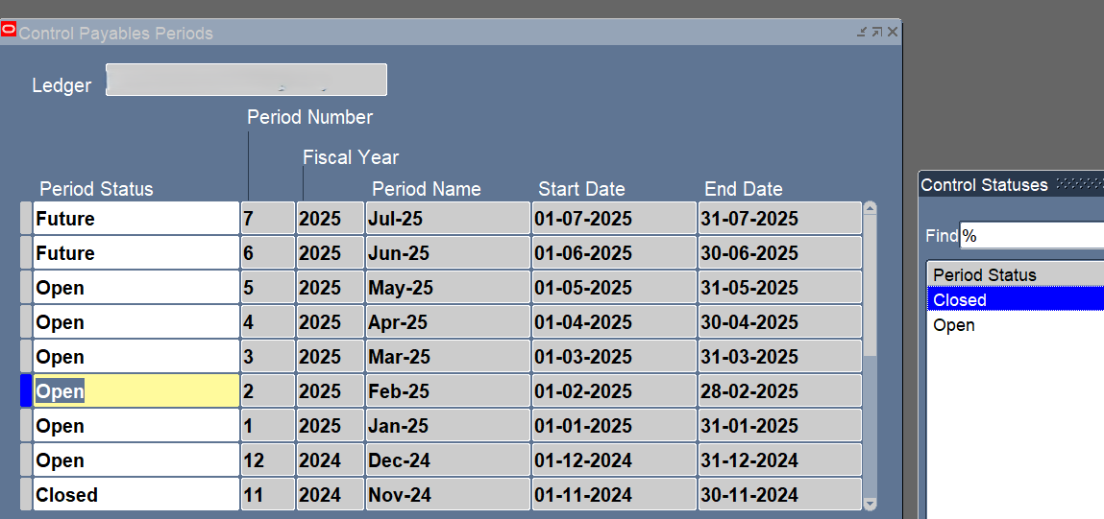
Open Payables Period
4
1
BLABN
2
3
1-Accounting - Control Payables Period
2-Enter The Ledger
3-open or close any period I wanted

Slide 10
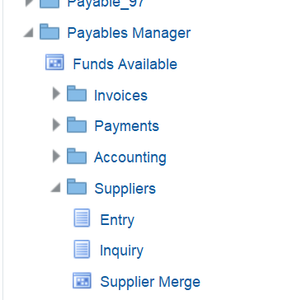
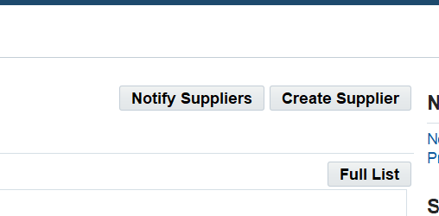
Create New Supplier
2
1
1-Suppliers – Entry
2-Create Supplier

Slide 11
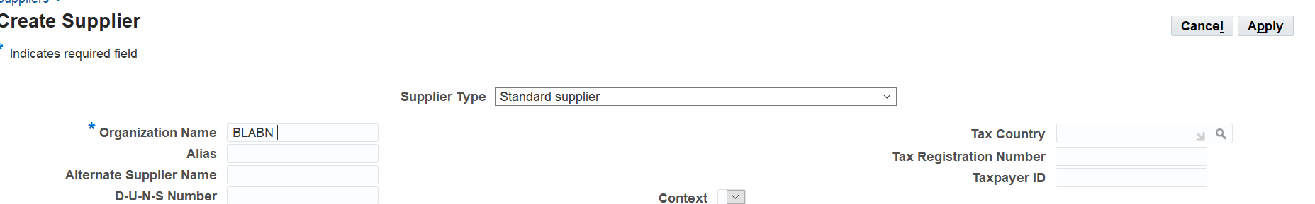
Create New Supplier
4
3
SUPPLIER
3-Enter Organization Name
4-Apply

Slide 12
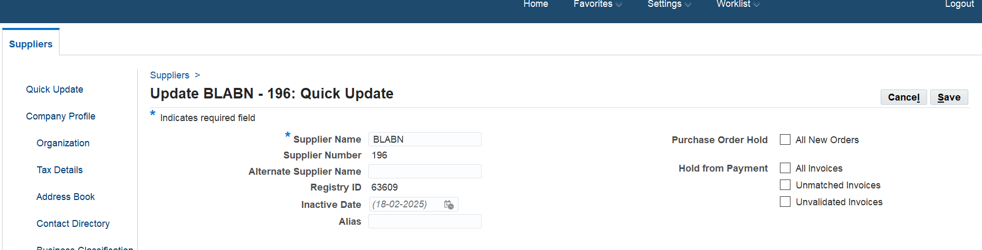
Create New Supplier
5
4
4-Enter Supplier Name
5-save

Slide 13
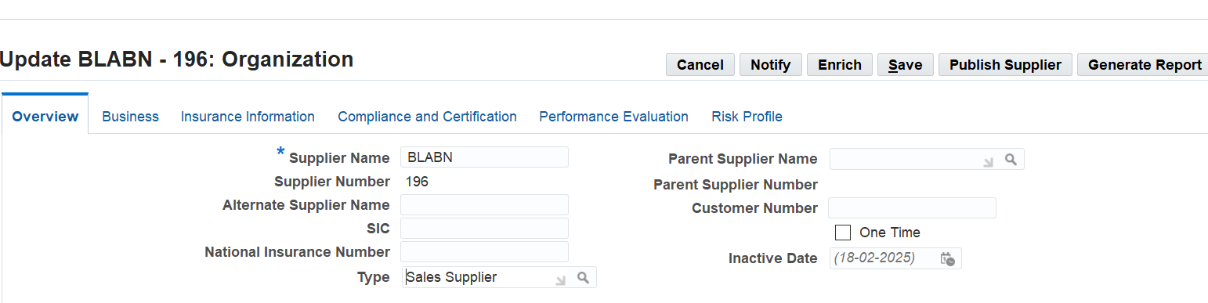
Create New Supplier
7
6
6- Enter type
7-save

Slide 14
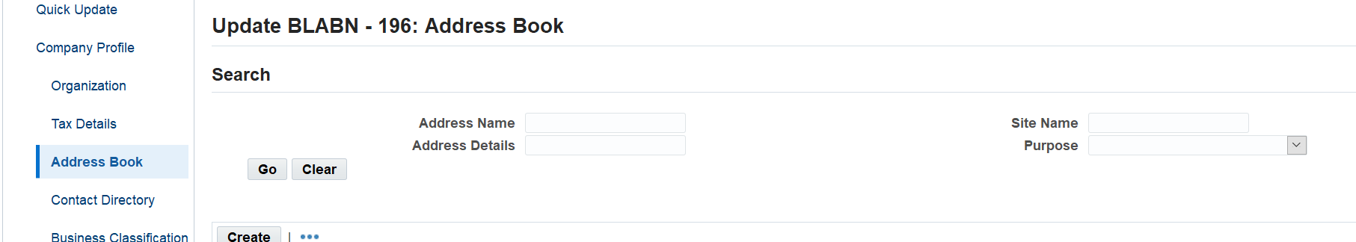
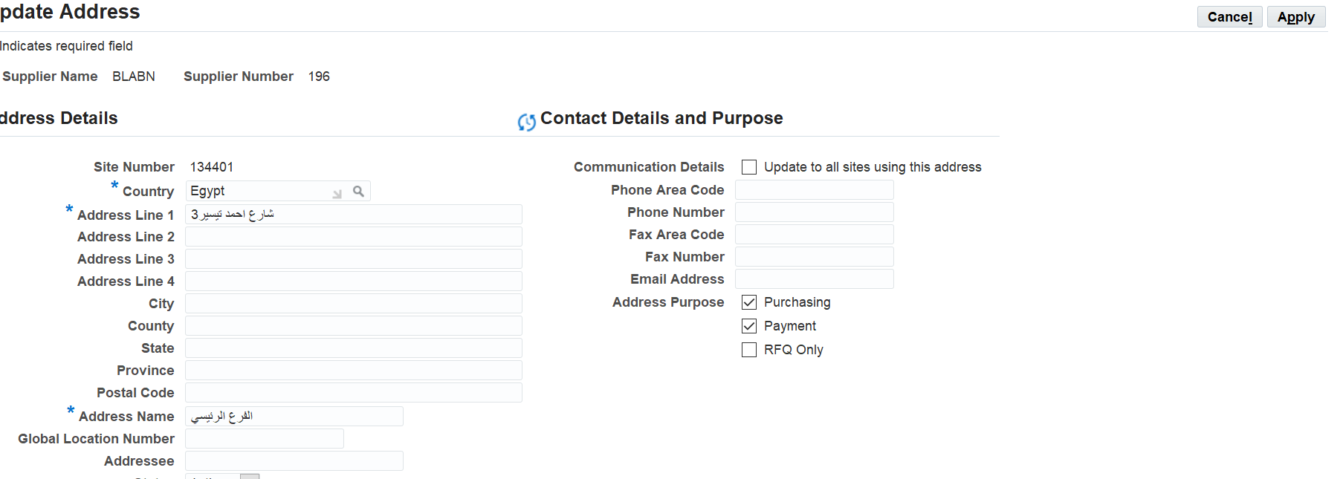
Create New Supplier
8-Create Address Book
9-Enter Country
10-Enter Address line
11-Enter Address Name
12-Apply
8
12
6
9
10
11

Slide 15
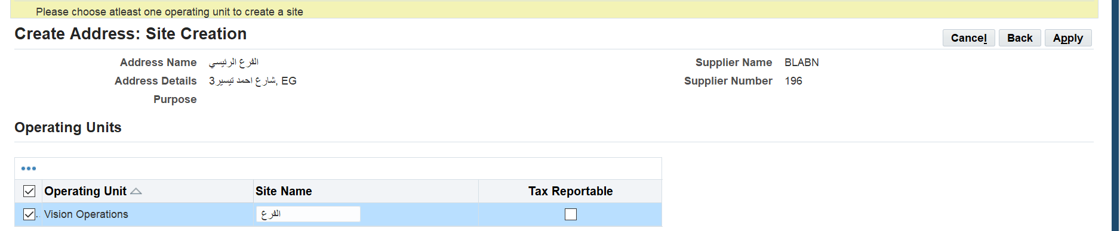
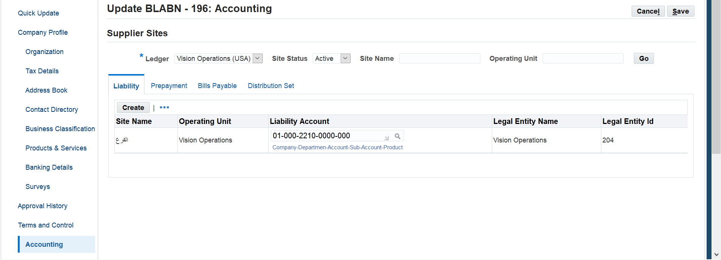
Create New Supplier
14
13-Select Site
14-Apply
15-Accounting
16-Enter Liability Account
17-save
13
6
17
16
15

Slide 16
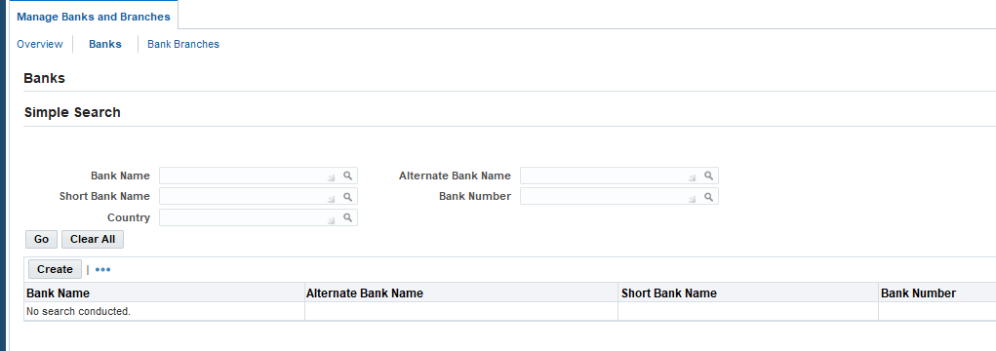
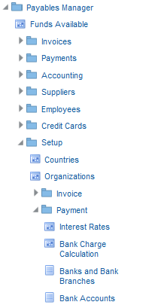
Create New Bank
2
3
1-Setup---Payment---Banks and Bank Branches
2-Enter To Bank
3-Enter To Create
1

Slide 17
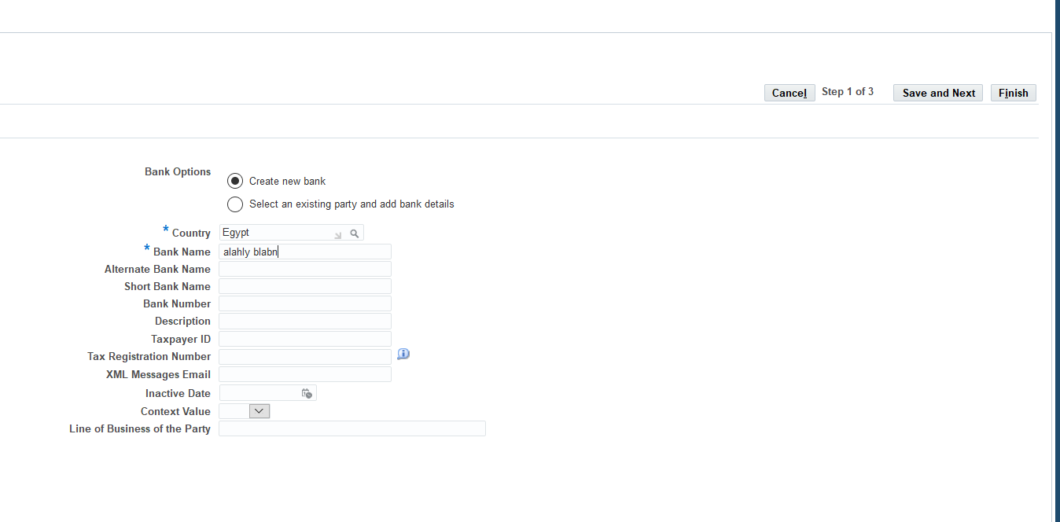
Create New Bank
6
4
5
4- Enter Country
5-Enter Bank Name
6-Save and Next

Slide 18
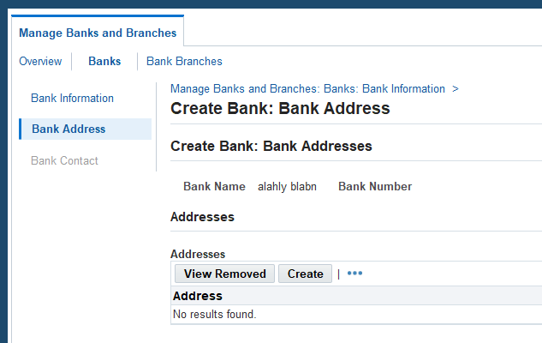
Create New Bank
6
6- Enter to Bank address
7-Enter to Create
7

Slide 19
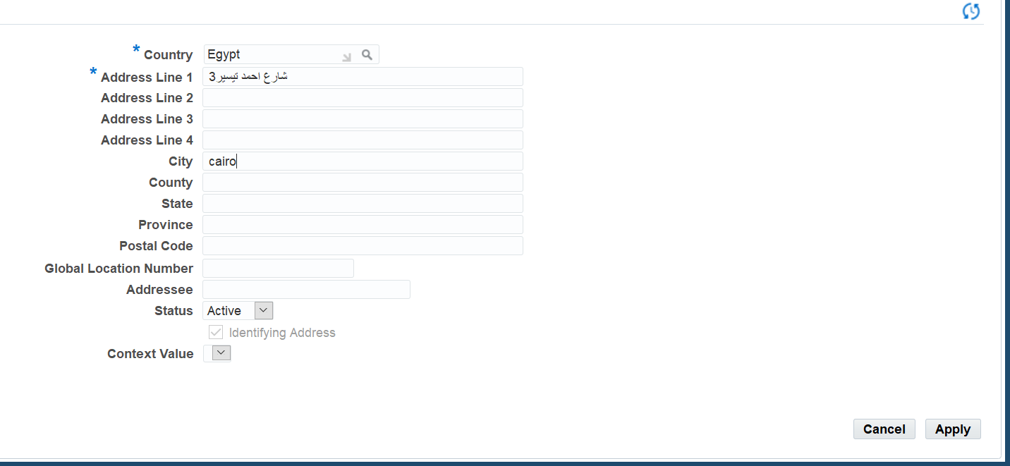
Create New Bank
8
9
8- Enter Country
9-Enter Address Line1
10- Apply
10

Slide 20
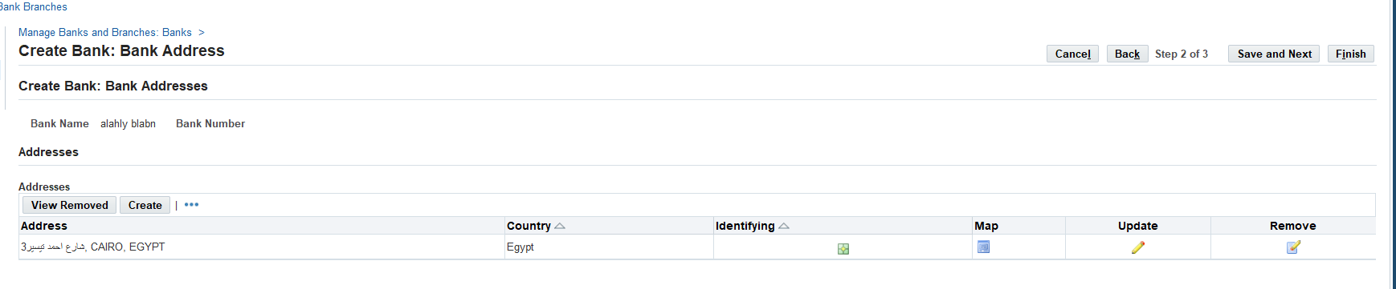
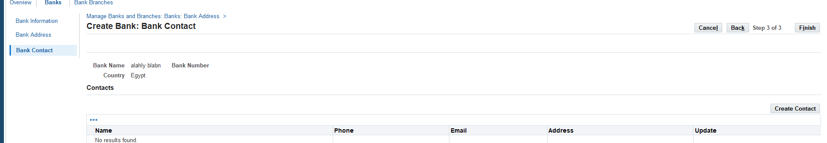
Create New Bank
11
11- Save and Next
12-Create Contact
12

Slide 21
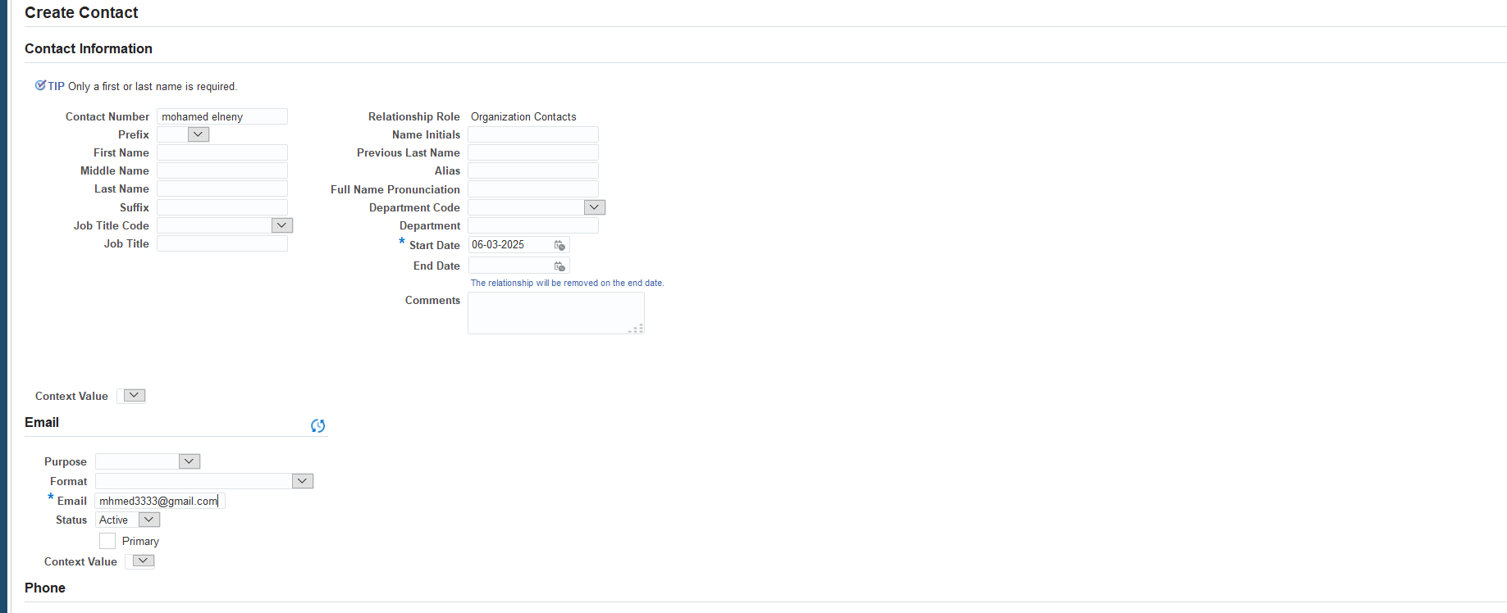
Create New Bank
13
14
13-Enter Contact Number
14- Enter Start Date
15- Enter Email
15

Slide 22
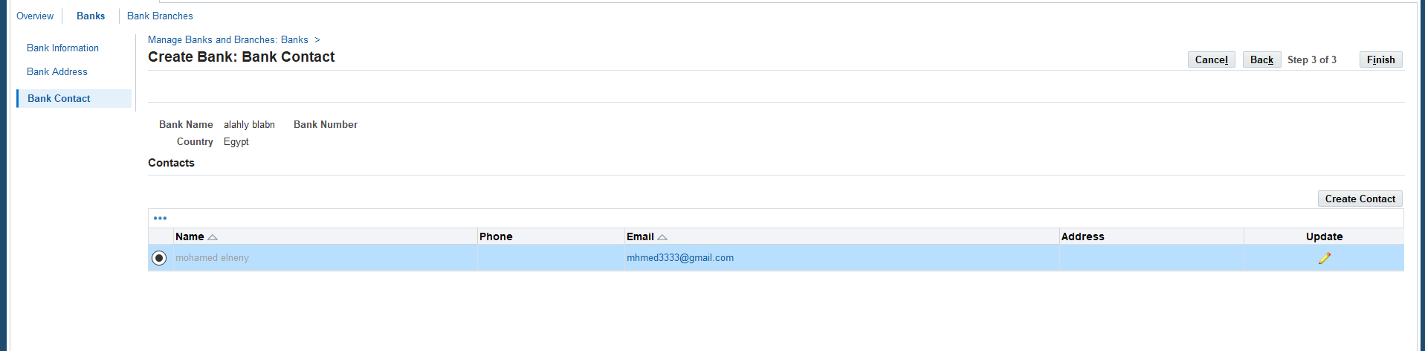
Create New Bank
17
16- Select Contact
17- Click to Finish
16

Slide 23
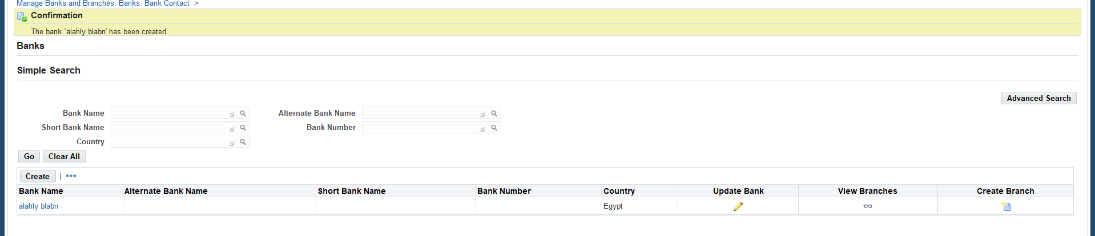
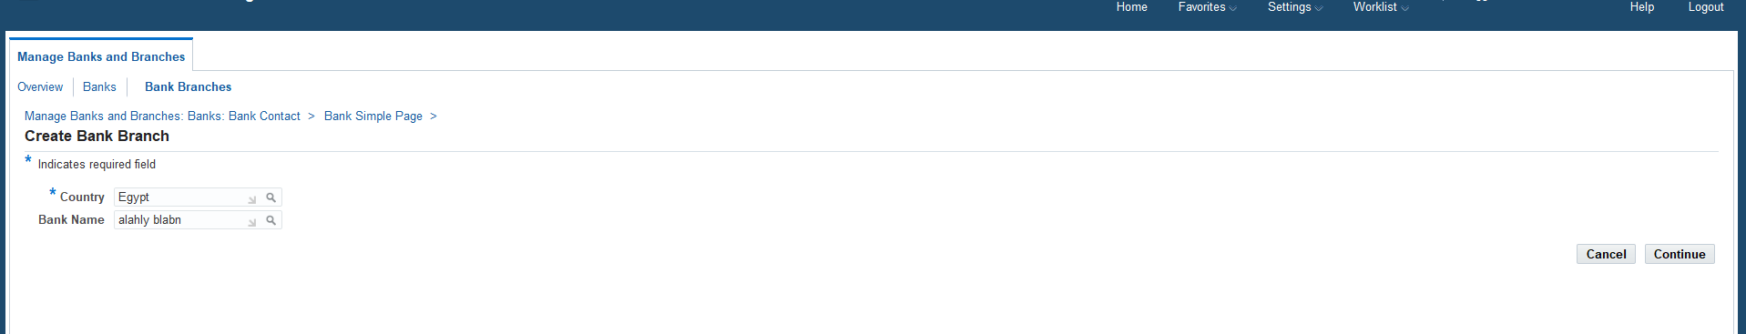
Create New Bank Branch
18- Create Branch
19- Enter Country
20-Enter Bank Name
21-Enter to Continue
18
19
20
21

Slide 24
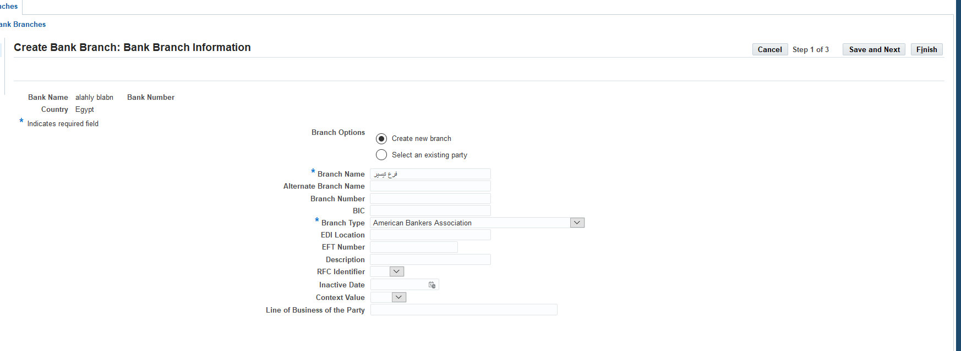
Create New Bank Branch
22- Create New Branch
23- Enter Branch Name
24- Enter Branch Type
25- Enter Save and Next
25
22
23
24

Slide 25
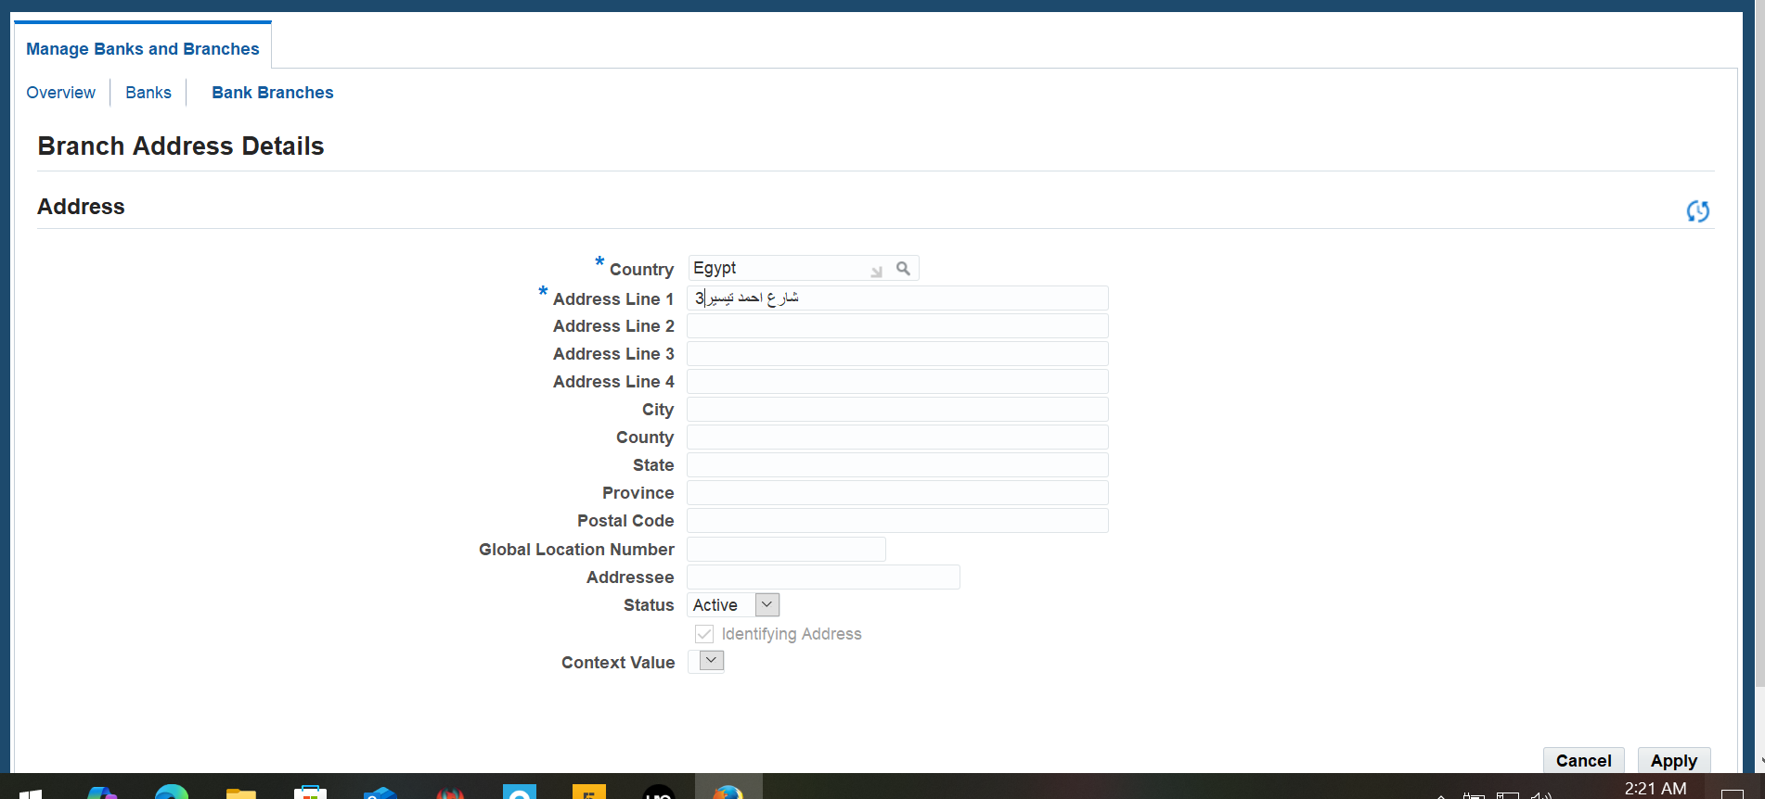
Create New Bank Branch
26- Enter Country
27- Enter Address Line
28-Apply
27
26
28

Slide 26
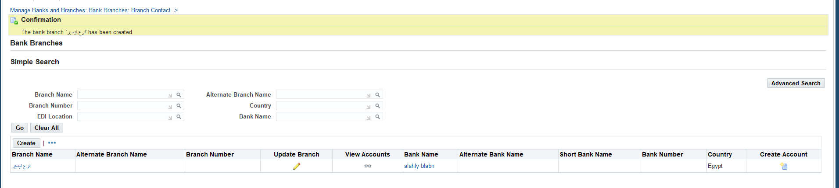
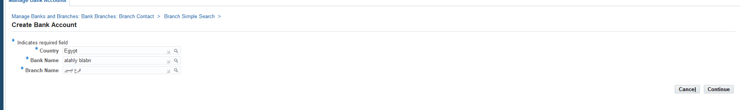
Create New Bank Account
29- Enter To Create Account
30- Enter Country
31- Enter Bank Name
32- Enter Branch Name
33- Enter to Continue
29
30
31
32
33

Slide 27
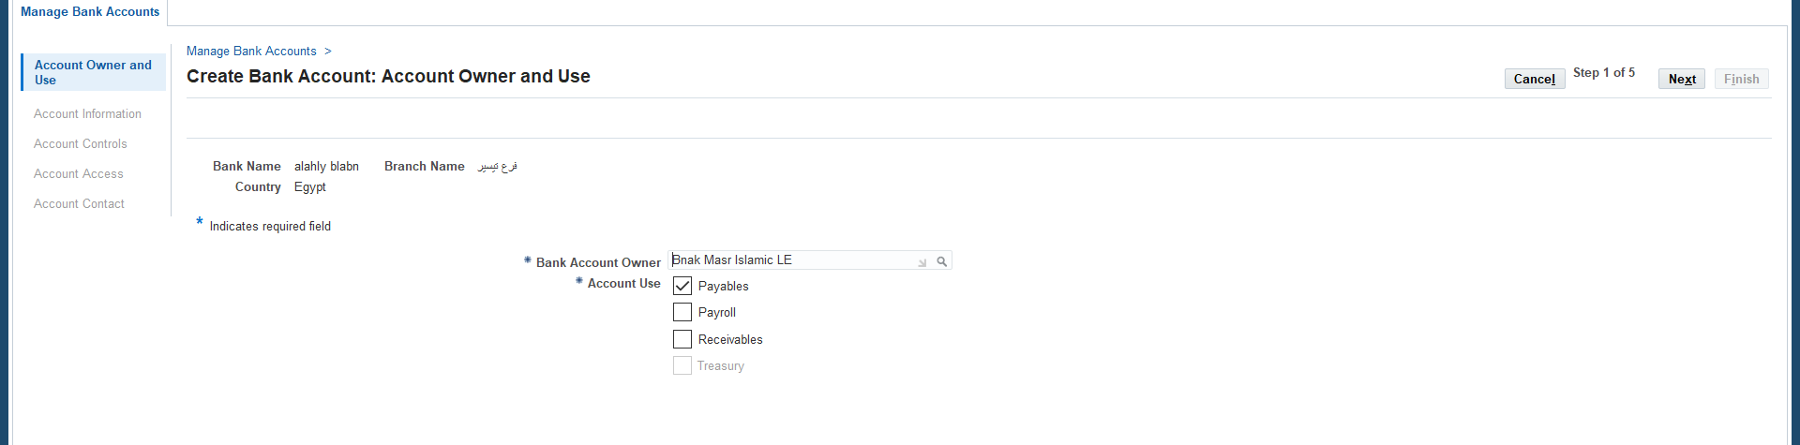
Create New Bank Account
34- Enter Bank Account Owner
35- Enter Account Use
36- Enter Next
36
34
35

Slide 28
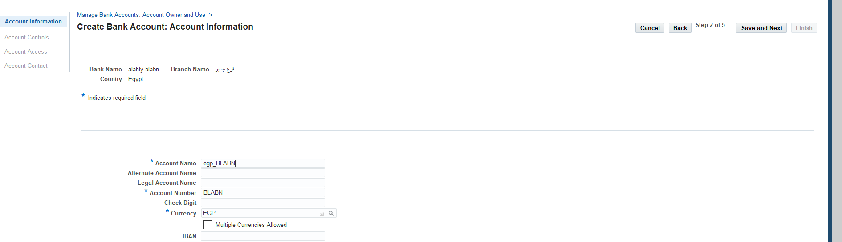
Create New Bank Account
39
37- Enter Account Name
38- Enter Account Number
39- Enter Save and Next
37
38

Slide 29
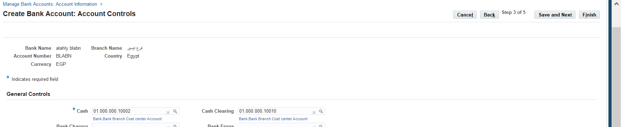
Create New Bank Account
41
40- Enter Cash Account and Cash Clearing
41- Enter Save and Next
40

Slide 30
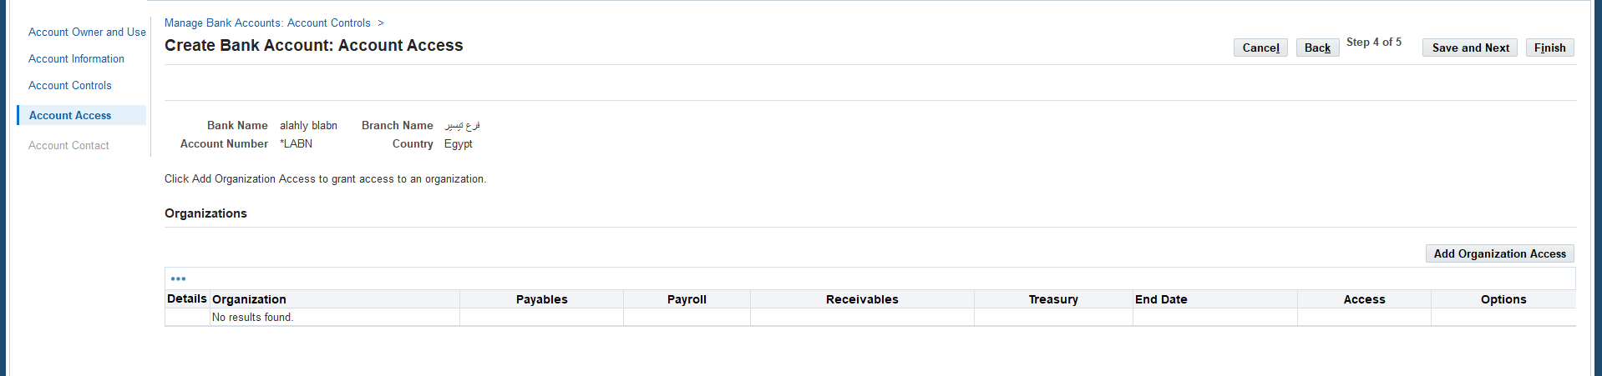
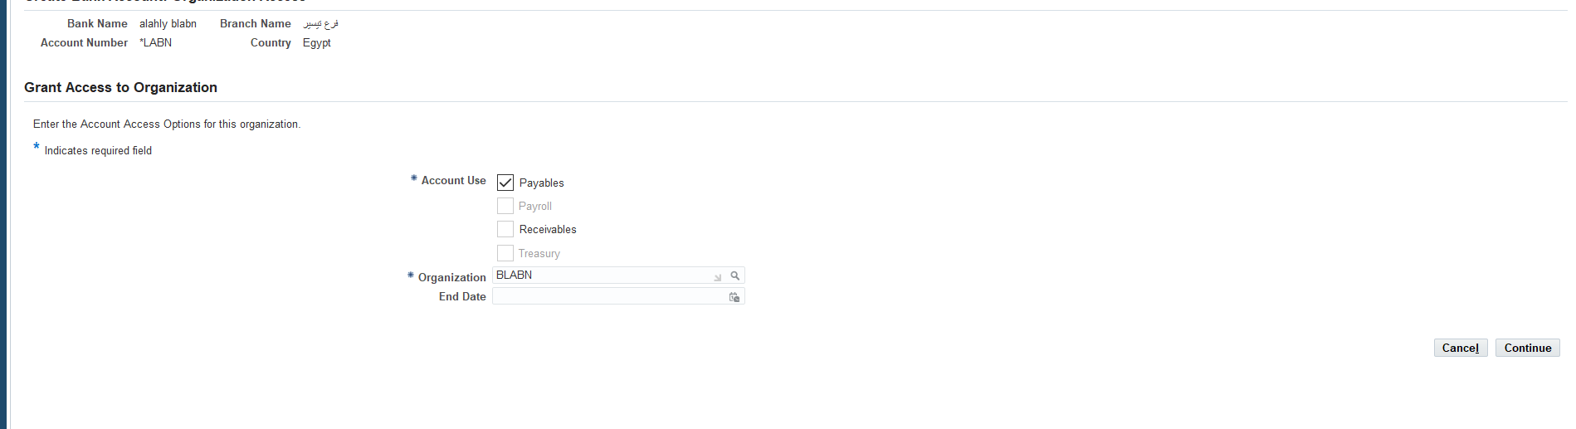
Create New Bank Account
42- Enter Add Organization Access
43- Enter Account Use
44- Enter Organization
45-Enter to Continue
42
43
44
45

Slide 31
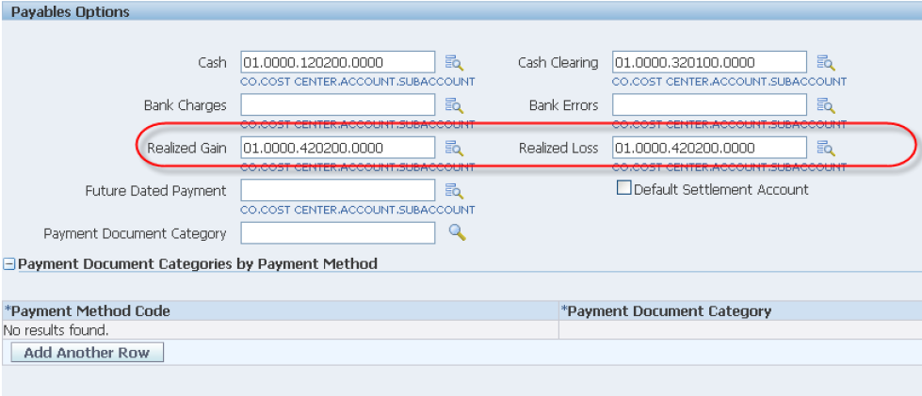
Create New Bank Account
46- Enter Gain and Loss Account
47- Enter Next
46

Slide 32
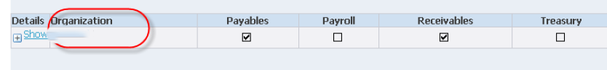
Create New Bank Account
48- Select Payable
49- Enter Finish
48
blabn

Slide 33
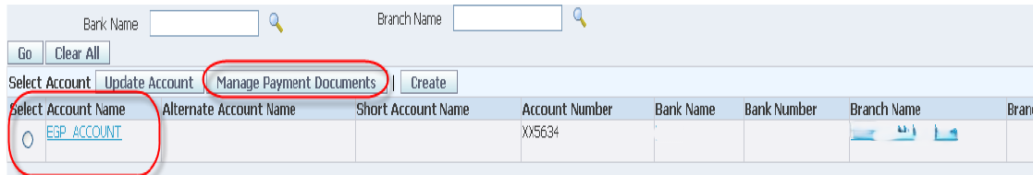
Create New Bank Document
50- Enter Manage Payable Documents
51- Enter Create
51
50

Slide 34
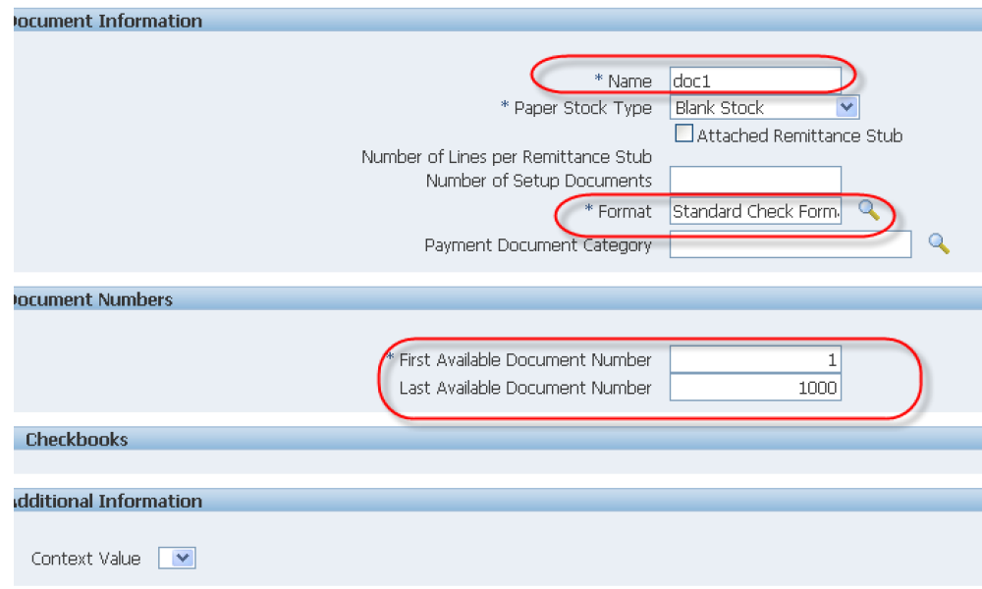
Create New Bank Document
52- Enter Name
53- Enter Format
54- Enter Documet Number
55- Enter Apply
52
53
54

Slide 35
Create Standard Invoice on new supplier

Slide 36
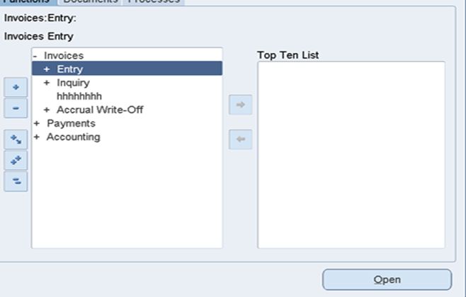


STEP1: INVOICES-------ENTERY--------INVOICES

Slide 37
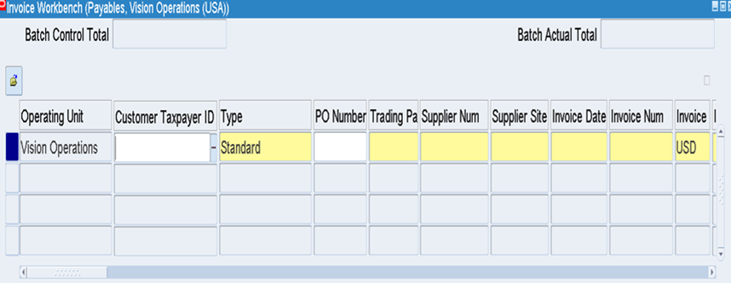


STEP2: ENTER INVOICE TYPE (STANDARD) ,THEN ENTER SUPPLIER’S NAME AND NUMBER , CHOOSE INVOICE NUMBER ,CURRENCY,INVOICE’S AMOUNT
Invoice type -----supplier’s name and number ------invoice amount

Slide 38
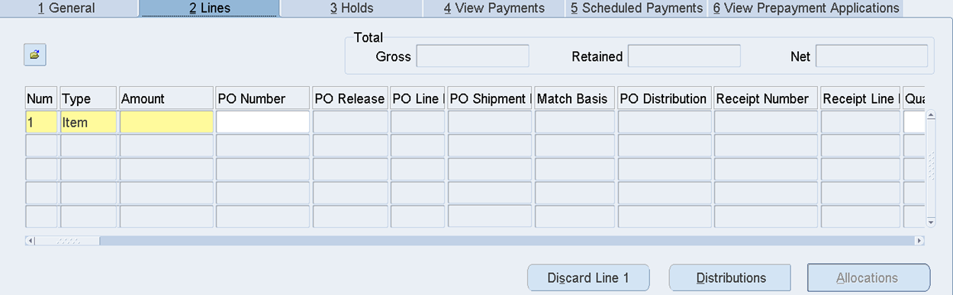



STEP3: CLICK ON LINE AND ENTER THE EXPENSE ACCOUNT THAT WE WANT TO ALLOCATE THE VALUE TO IN THE GL AND A DESCRIPTION OF WHAT WE PURCHASED
STEP4: CLICK ON DISTRIBUTION TO DISTRIBUTE THE LINE VALUE TO MORE THAN ONE ACCOUNT
STEP5: CLICK ON SAVE
Line -------expense account --------distribution --------save
5
4

Slide 39


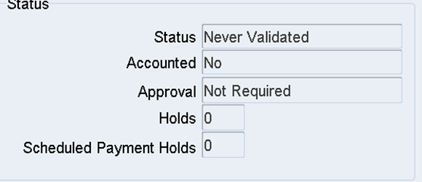


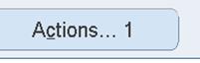


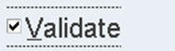
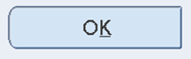
Invoice status not validated------action1------validate-------ok

Slide 40
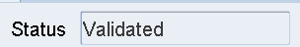
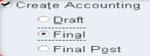

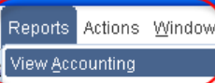
invoice status is validated -------action1-------create accounting-----
final-----ok-------accounted is “yes”------reports------view acconting

Slide 41
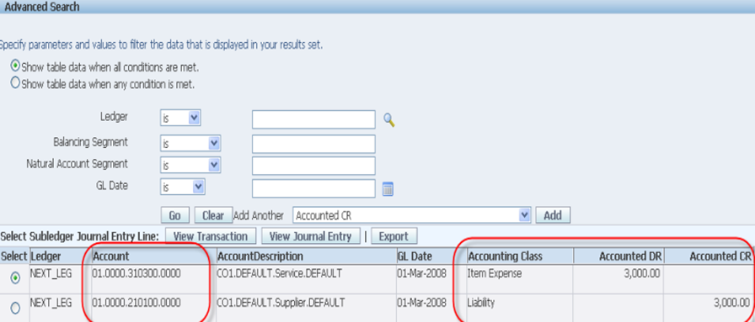



B.LABAN
B.LABAN
Check accounting class , accounted DR,CR

Slide 42
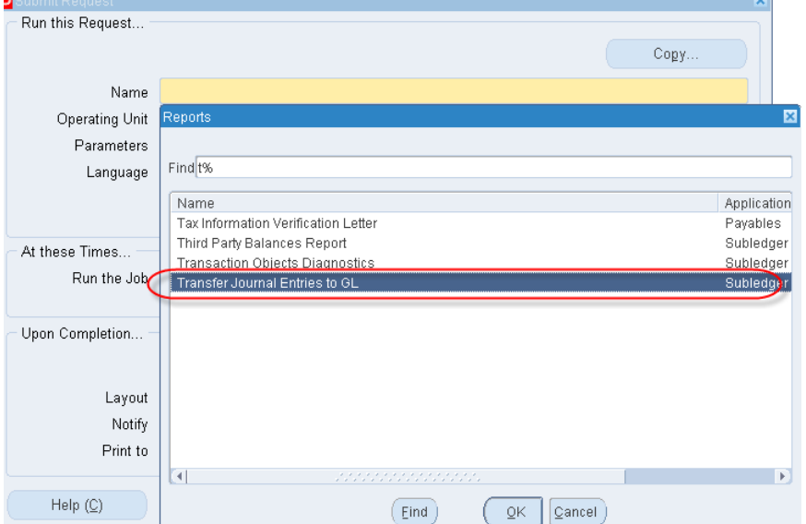
Find---------transfer journal entries to GL

Slide 43
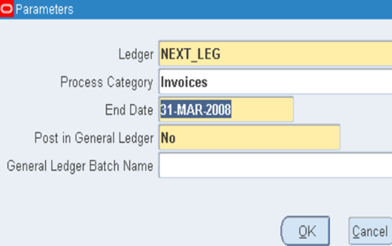
After the request is completed, we can view it in the GL from the "Enter Journal" screen and then post it.
B.LABAN
Request is” completed”------”enter journal”--------view GL -------screen and post

Slide 44
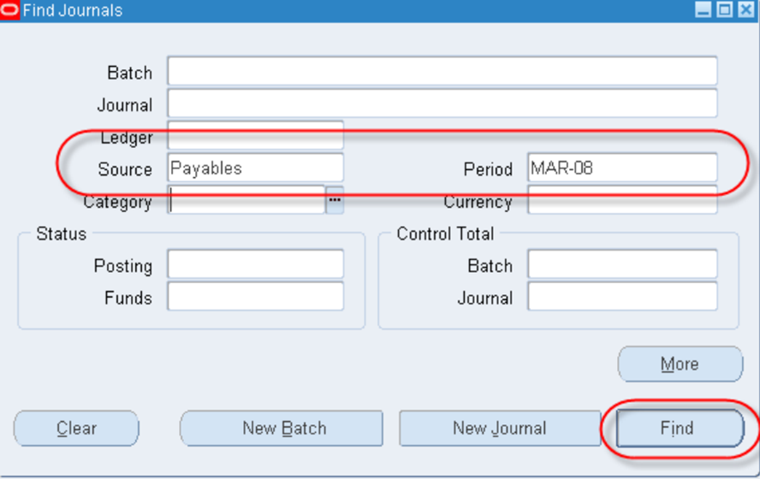


Find journals-------source ”payables”--------period”mar-08---------find------batch status is “posted”

Slide 45
CREATE USD STANDARD INVOICE

Slide 46


the same process as we did before, with the difference being that we will enter the invoice in USD, but in a “foreign currency”.
(B.LABAN-AP)
1
BLABAN
BLABAN-SU
Same processes with USD-------complete invoice --------post to GL

Slide 47




Then, we complete the invoice as usual and post it to the GL
(B.LABAN-AP)
B.LABAN

Slide 48
PAYMENT : STANDARD INVOICE

Slide 49

In order to work on settling PAYABLE , banks must be defined first
. Setup---Payment---Banks and Bank Branches -------Enter to Bank ----- click on Create
1

Slide 50


3
2
Indicates required field -------enter country and bank name-------save next

Slide 51

4
Bank addresses ------------create

Slide 52




5
6
7
Enter country name ----- addresss for line 1----city name-----apply-----save and next

Slide 53

8
Create contact---------finish

Slide 54





9

Slide 55

10
Create branch-------”branch options”-------create new branch

Slide 56





11
Click on continue--------Enter bank name and country---------save and next

Slide 57

enter branch address-------- to enter contact name
------”save and next” or “finish”

Slide 58


12

Slide 59


13
User management------roles& role inheritance--------create role

Slide 60

14

Slide 61

15

Slide 62



Slide 63


Choose category--------name the code------ choose application-------save From Security wizard
-----choose legal entity ------click on bank account transfer ,maintenances and USE
---------APPLY-------save

Slide 64


Slide 65

From “user maintenance”---------choose “user”-------”Go”-------update
Assign Roles------ role” my bank”-----select------write “the justification”-----save

Slide 66


Bank accounts----create
Enter country, bank name and branch name ------continue
choose payables and receivables------next------put account name ,number and currency and if
“multiple currencies allowed-----
Next ----- save and next
B.LABAN

Slide 67



Slide 68

Add organization access ------choose “payables and receivables”------continue----
“gain/loss” of Exchange rate differences---------finish

Slide 69



B.LABAN

Slide 70

B.LABAN
To define payable document →“Manage payment documents”----------create------name the document and make format ------choose “first available number” ---------apply

Slide 71



Slide 72


Slide 73


Payment administrator--------go to task “payment process profiles--------create-------apply

Slide 74


Slide 75



B.LABAN-PAYMENT
B.LABAN-PAYMENT

Slide 76



Back to payment after defining bank
Invoice------action1-------pay in full-----ok
Payment process profile -----save

Slide 77


B.LABAN-AP
B.LABAN
B.LABAN-AP
B.LABAN-AP
B.LABAN-PAYMENT

Slide 78


B.LABAN
B.LABAN
Action1 in “payment”-------- tools-------view account Or (Payments-----entry-------payments)

Slide 79


enter payment type and supplier name --------move to right for “enter bank, date and amount
B.LABAN
B.LABAN-supp1
(B.LABAN-AP)
(B.LABAN-AP)
B.LABAN-supp1

Slide 80

(B.LABAN-AP)-BLABAN,7-BLABAN-SUPP1
click on “enter/adjust invoice” to put number of invoice -------save

Slide 81


Action1----create account -------ok

Slide 82



in “payment”-------- tools-------view account
B.LABAN
B.LABAN

Slide 83
CANCEL INVOICE

Slide 84


Slide 85


(B.LABAN-AP)-BLABAN,7-BLABAN-SUPP1
1
Invoice distribution -------line-------reverse1
3
2

Slide 86

4.Then we “adjust the invoice value” and perform” invoice validation” and account creation as with any previous invoice
(B.LABAN-AP)
4
BLABAN

Slide 87



Action1------cancel invoice-----ok
Invoice status ” cancelled”
5

Slide 88






Slide 89
CREATE CREDIT AND DEBIT MEMO

Slide 90

Credit memo→ use it to make me able to cancel the invoice
Debit memo→ use it to make supplier able to cancel the invoice
Debit
Choose “credit or debit” from “TYPE” -------- make “the amount “ with “MINUS”

Slide 91

Match action --------invoice --------corrections --------enter invoice number ---------find

Slide 92


Invoice amount in “LINE“--------validation and create account

Slide 93
CANCEL PAID INVOICE

Slide 94



Action1--------void------ write date of cancelling -------ok
Action1 ------create account------invoice action “none”

Slide 95



Slide 96


Create Recurring Invoice
step1.Open the Recurring Invoices Form
Navigate to: Payables, → Invoices → Entry → Recurring Invoices
Step 2: Fill in Supplier and Calendar Information
Step 3: Fill in Invoice Definition
Step 4: Enter Accounting Information
Step 5: Set Invoice Quantity
Step 6: Generate the Invoices

Slide 97

Accounts Payables Closing Process and Transfer to General Ledger
.Validate the Invoices
Step 1: Open the Invoice Workbench:
Payables→ Invoices → Entry → Invoices
Step 2: Query the Invoice
Step 3: Validate the Invoice
Click the Actions button (bottom left)
Step 4: Confirm Status
The invoice status should change from:
Never Validated → Validated

Slide 98

Create Accounting
Step 1: Open the Request Window
Go to the top menu: View → Requests → Submit a New Request
Step 2: Run "Create Accounting"
Choose: Single Request
Request Name: Create Accounting
Step 3: Enter the Parameters
Ledger: Vision Operations
End Date: 31-DEC-2025
Mode: Final
Report: Yes
Transfer to GL: Yes
Post in GL: Yes (if required)
Include User Transactions: Yes (if shown)

Slide 99

Close the AP Period
Step 1: Go to: Payables → Accounting → Control Payables Periods
Query: Ledger = BALABAN
Locate DEC-2025
Set Status to: Closed
Click Save

Slide 100

Account Payables Reports
Step 1: Submit and View Output
Click Submit
Wait for Status: Completed – Normal
Click View Output to download and view the report

Slide 101

Expense Report
To create an Expense Report .
(Setup-Invoice- Expense Report Templates)

Slide 102

Expense Report
To create an Expense Report
1- Setup--- Invoice--- Expense Report Templates

Slide 103

Expense Report
To make an Expense
(\ Invoice---Entry--Expense Report)

Slide 104

Expense Report
To Select an Expense
(Other – Request – Run - Expense Report Export)

Slide 105

Expense Report
Enter the batch name then choose payable then click on (Submit)

Slide 106

Expense Report
Action 1 button
- Validation / Create account

Slide 107

Expense Report
Pre-Payment

Slide 108

Expense Report
Invoice / Entry / Expense Report / Advanced Apply

Slide 109

Expense Report
Final Result

Slide 110

Recurring Invoice
Distribution Set
Special Calendar
(Setup—Calendar---Special Calendar)

Slide 111
Recurring Invoice
- Distribution Set
Creating Special Calendar
(Setup—Calendar---Special Calendar)

Slide 112

Recurring Invoice
(Invoice/Entry/Recurring invoice )

Slide 113

Recurring Invoice
Open Amounts to enter the amounts

Slide 114

Recurring Invoice
Create Recurring Invoices
Batch / Ok

Slide 115

Recurring Invoice
To create another one
1- recurring invoice
2- Create Recurring Invoices

Slide 116

Withholding Tax Invoice
To create Tax invoice
(Setup—Options—Payable)
-Use Withholding Tax
-Allow Manual Withholding
-Apply Withholding Tax
-Allow Manual Withholding
-Special Calendar (withholding)

Slide 117

Withholding Tax Invoice
-Special Calendar (withholding)

Slide 118

Withholding Tax Invoice
-Organization ( Tax Authority )

Slide 119
Withholding Tax Invoice
-Organization ( Tax Authority )

Slide 120

Withholding Tax Invoice
Setup—Tax—Codes

Slide 121


Withholding Tax Invoice
Validations
create Account
withholding tax

Slide 122

Cash Management
-For GL Ledger
(Chart of Account , Calendar , Currency ,Account Method )
-For Payable
(Setup—Option—Payable)

Slide 123

Cash Management
-Payable
(Setup----Payments----Bank Account)

Slide 124

Cash Management
-Payable
(Setup----Payments----Bank Account)

Slide 125

Digitizing the Accounts Payable System at
B. LABAN Using Oracle ERP

